Slide 1

Food Prices and the Poor:
The Differential Welfare Effects of Price Levels and Volatility
Chris Barrett
Cornell University
International Agricultural Trade Research Consortium
General Meeting Theme Day
St. Petersburg, Florida
December 11, 2011

Slide 2
Factual background
Since 2007, real food price levels and volatility have risen sharply as compared to the preceding 17 yrs:
2007-11 mean >70% higher over 1990-2006,
and coefficient of variation up >120%
Data source: FAO food price index, 1/1990-10/2011

Slide 3
Causes
Why higher, more volatile food prices?
Confluence of demand and supply side factors:
Continued significant demand growth in emerging markets
Increasing diversion of food and feed to biofuels production
Weather shocks in major growing reasons
Financial mkt spillovers/increased commodity speculation
Trade policies/gov’t purchases aggravate problems
Much dispute as to the weighting among factors
Key summary statistic:
Stocks-to-use ratios fall and then prices rise and become more volatile following the basic economics of storable commodity prices (Williams and Wright, Deaton and Laroque, etc.).

Slide 4
Consequences
Differentiate between levels and volatility
A key error in contemporary policy dialogue:
Policymakers and commentators routinely conflate high price levels – a cross-sectional mean – with high food price volatility – a (fn of) time series variance – perhaps because they have same underlying causes, so naturally correlated.
But food price levels and food price volatility have different consequences for different groups.
This matters, especially for the political economy of current policy dialogues about the “food price crisis”.

Slide 5
Consequences
The welfare effects of price levels
Well understood:
Buyers lose, sellers gain from higher prices.
Easily reflected in “net benefit ratio” (marketable surplus as proportion of income)= welfare elasticity wrt price (Deaton).
Typically increases w/ income in developing countries
Empirical regularity:│NBR<0 │ > │ NBR>0 │. Therefore, food price rises hurt more than symmetric price drops.
Source: Barrett and Dorosh (1996 AJAE)

Slide 6
Consequences
The welfare effects of price volatility
Well understood:
Sellers worse off from price risk (Baron 1970, Sandmo 1971).
Less well understood:
Welfare effects of price risk are ambiguous for net buyer households (Newbery & Stiglitz 1981, Finkelshtain & Chalfant 1991, Barrett 1996). If most of the poor live in such households, how do volatile food prices affect the poor?
Put differently, who favors more stable food prices, poorer net food buyers, better-off net food sellers, or both?

Slide 7
Consequences
The welfare effects of price volatility
Bellemare, Barrett & Just (2011) derive an expression for multivariate price risk aversion and compute the WTP for price stabilization (build on Finkelshtain & Chalfant 1997):
The sign is ambiguous. For sellers (M, β>0), however, it’s almost surely positive. But what about for buyers and what’s the distributional implication of price risk preferences?
Bellemare, Barrett & Just (2011) use panel data from rural Ethiopia to explore that question.

Slide 8
Consequences
The welfare effects of price volatility
Result: The best off 40% of hhs favor price food stabilization; the poor (but not very poorest) favor unstable prices.

Slide 9
Consequences
Summary of welfare effects of
high and more volatile food prices
If risk effects are second-order compared to levels effects:
Price risk averse net buyers unambiguously worse off … but it’s unclear how many such people there are.
Price risk loving net buyers are worse off, but greater price volatility limits losses.
Net sellers are better off, but more price risk limits gains.

Slide 10
Indirect corroboration
Resulting political unrest
Well understood:
High food prices (or resulting policy responses, such as “land grabs”) sow sociopolitical discontent in developing countries: e.g., Haiti, Madagascar 2008; Egypt, Tunisia 2011.
Less well understood:
Higher food price volatility is negatively associated with political unrest in developing countries once one controls (even instruments) for food price levels, which exert a strong positive effect on political unrest (Barrett and Bellemare 2011; Bellemare 2011).

Slide 11
Policy implications
Current food price policy dialogue
But the push for reducing price volatility, rather than for reducing price levels, implicitly favors better off producers (e.g., in Europe, North America, Australia, Brazil) over poorer consumers globally.
Hence Marc Bellemare and my July Foreign Affairs paper:

Slide 12
Policy implications
Current food price policy dialogue
Prices will come down and stabilize naturally if/when/as supply-demand balance restored and food stocks replenish.
There are high opportunity costs, especially for poorer net consumers, to resources (e.g., $, technical skill, political attention and will) devoted to active food price stabilization over:
accelerating supply expansion via productivity growth or
facilitating price stabilization through agricultural trade liberalization and improved physical and institutional infrastructure for food distribution in poor areas.

Slide 13
Policy implications
Current food price policy dialogue
Yet typical (misguided) statements by prominent people include claims such as:
French President Sarkozy: “If we don’t do anything [about food price volatility], we run the risk of food riots in the poorest countries.”
World Bank President Zoellick: “[Food] prices remain volatile and millions of people around the world are still suffering. The World Bank has been working … to protect the most vulnerable from the dangers of food price volatility.”
Homi Kharas, Brookings: “The crux of the food price challenge is about price volatility rather than high prices per se. It is the rapid and unpredictable changes in food prices that wreak havoc on markets, politics, and social stability.”

Slide 14
Policy implications
Current food price policy dialogue
At least three candidate explanations:
1) Genuine confusion over terms. Volatility is a latent concept proxied by a variety of statistical measures about which lay people are typically imperfectly informed.
2) Conflation of correlation with causality. High food prices harm the poor and cause political unrest. And high food price levels and high price volatility are correlated.
3) Political capture. Powerful farm lobbies are able to use populist language to tilt policies to benefit small, better-off interest groups.

Slide 15
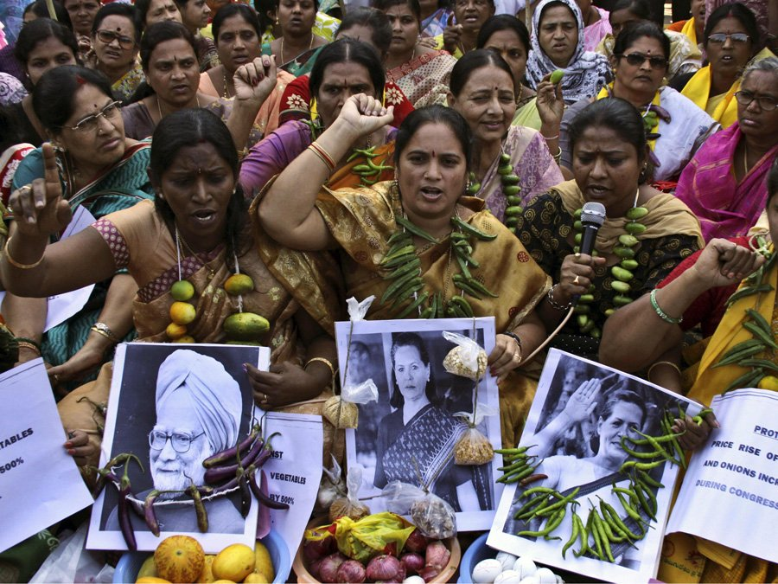
Thank you
Thank you for your time, interest and comments!
Food price inflation protests in Hyderabad, India, Monday, Jan. 10, 2011.
AP Photo/Mahesh Kumar A, from businessinsider.com

